Slide 1

Microgrids for Consulting Engineers
IEEE Atlanta, GA Chapter USA
May 20, 2019
schneider-electric.us/microgrid
#EcoStruxure #Microgrid
Notes:
This is an example of a Title Slide. We need to convey Life Is On in everything we do, so try to lead with compelling images that are vibrant, authentic, and human. The human element should be apparent and within the context of a segment that we touch.
To keep this PowerPoint template file size reduced, we included a small library of image choices in the Slide Master (under View). You can also get them from the SE Asset Library: https://schneiderelectric.telescopeondemand.com

Slide 2

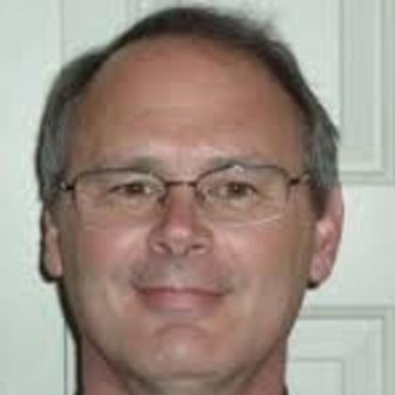
Microgrids for Consulting Engineers
New Energy Landscape, expanding DER
Microgrid project drivers and use cases
“Anchor resources”
Project development
Studies, interconnect, and project fatal flaws
Energy Control Centers
Energy Storage and inverters
About this presentation:
Given for CEUs for CIAPR
The link below has a one hour recording for additional PDHs.
https://event.on24.com/wcc/r/1512941/6E6F1149D0487843F933A8D43C1D65E1
Microgrid Competency Center N.A.
Philip Barton
Sr. Director – Microgrid Competency Center N.A.
philip.barton@SE.com
Ken Box
Sr. Consulting Engineer Specialist
Ken.box @SE.com
770-773-5136

Slide 3
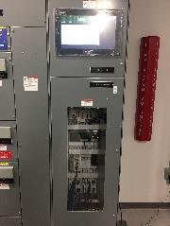
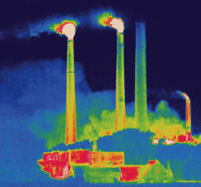
Three D‘s of the New Energy Landscape:
  1
Decentralization
.
.
.
11% , or 110 GW of energy production in U.S. is now Distributed Energy Resources (DER), with solar PV and CHP growing fastest
Centralized Generation
Transmission
Distribution
Retail
  2
Decarbonization
Prosumer
Utilities average < 35% “combined” efficiency “at the plug”
Low carbon - cogen/gas DER is 55 – 90% efficient at the plug (½ to 1/4 the GHG)
No carbon - solar (and some wind) is BTM and fastest growing DER no carbon
  3
Digitization
Communication and control to autonomously and dynamically mange intermittent renewables for cost avoidance and resiliency
Enable the prosumer and flatten utility load curves
2011 DOE Tech. Review used this thermal image of a house in front of a coal fired plant to illustrate that the average coal plant only converts 33% of it’s energy to electricity, the rest is lost as heat
Notes:
Thank you for being here today, I hope you have seen how our new, flag ship Microgrid offers of EMA and SE Energy Control Center are helping our clients thrive in the new energy landscape. Decentralized energy, Decarbonization and Digitization provide more opportunities for our clients, our employees, and our shareholders to thrive in the new energy landscape.

Slide 4
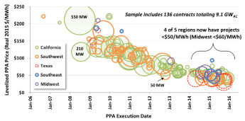
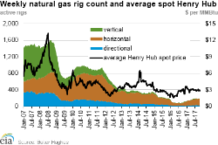
Driving the New Energy Landscape
Inexpensive Gas
Inexpensive Solar
North America, wholesale gas prices are still ½ to 1/3 Europe and Asia, about U.S. $ 2 - $ 4 MMBtu
Solar PV is a cost effective tool for lowering an organization’s energy bill. Non-Residential costs average U.S. $0.05 to $0.12 per kWh.
Solar generation is often at peak production when electricity demand and prices are the highest
Notes:
http://newscenter.lbl.gov/2016/08/24/median-installed-price-solar-united-states-fell-5-12-2015/
Cheaper solar and nat gas are changing everything
Especially where power costs are high or the spark spread is wide
NA Facts Wind and Solar out pacing fossil fuels – 56 GW addn by 2020 vs 36 GW
Enter the prosumer...

Slide 5
What is a Microgrid? ... an “Advanced Microgrid?”
An integrated energy system consisting of interconnected loads and distributed energy resources…
In Normal Operations
In Island Mode
DER (Distributed Energy Resources)
DER (Distributed Energy Resources)
On-site renewables and power generation facilities utilized in parallel with grid
Microgrid will generate energy from local sources in the case of a grid outage
Client Campus
Switch
Buildings
Grid
Utility Meter
Grid
Data Centers
During an outage or event, the microgrid controller isolates connection to the grid as needed
May be possible to sell excess power back to the grid through a net metering contract
…which can be controlled as a single entity and operate connected to the grid or in an intentional islanded mode.

Slide 6
District Energy Microgrid
Combined Heat and Power (CHP) Microgrids provides superior reliability and efficiency, meeting a site’s thermal needs in addition to its electrical needs, around-the-clock, even in the event of a grid outage.
  Steam, hot water and chilled water is produced at District Energy Centers
  Environmentally Sound, more efficient than grid distributed power
  Retrofits chillers and boilers buildings do not need their own plants
  Easier to operate and maintain
  Provides Energy Architectural Flexibility and Security
DER (Distributed Energy Resources)
Steam
Hot water
Chilled water
Healthcare
Campus
Switch
Buildings
Grid
Utility Meter
Labs/Offices
Combined Heat & Power generation units can be used to generate a range of energy products during both normal and emergency conditions.
Emergency
Notes:
SOOO... Microgrid is really a synonym for “distributed energy resources (DER)”
Point is, DER in “continued parallel operation” alone is 11% of the U.S. Grid alone! That’s right, 100 GW of the 1000 GW is CHP, Solar, and other sources of generation in continued parallel operation. Very little of this “islands” autonomously!
Understand UL 1741
Understand IEEE 1547

Slide 7




Microgrid Drivers
How your Customers are Thinking About Energy in a New Way
  Cost
  Lower / More Predictable Energy Costs
  Energy / Fuel Source Arbitrage
  Flexibility drives savings / incremental revenue
Efficiency
$
  Resilience
  Serve loads during times of grid stability
  Oasis for employees / customers – shelter in place
  Protect power sensitive / critical assets from poor power quality
  Cost
  Resilience
  Sustainability
  Sustainability
  Reduce carbon footprint
  Improve brand image
  Attract / Service carbon sensitive customers
Page 7

Slide 8


What are Key U.S. Geographies for Microgrids?
Facilities located in North East, West and Caribbean where power costs are greater than $.12 $.16 per kWh, energy users with “peaky” loads
Spark Spread – where energy produced locally from natural gas or bio gas is less expensive than energy purchased from the electric utility including areas where power is $ .04 to $ .12 an hour or more
Market segments that value resiliency and sustainability
  Governments, military, storm prone areas
  Healthcare, data centers, municipalities, corporate campuses, industry
California
Puerto Rico
Massachusetts
New York
New Jersey
Maryland
Notes:
PA
RI
TX

Slide 9
Why do your customers need your help with microgrids?
Expensive infrastructure may be required to address these challenges, resulting in a typical ROI of 5-25 years
Rebates and incentives are plentiful but may be difficult for end user campuses to understand and access (no internal expertise/bandwidth)
Microgrids are complex and require deep technical expertise to design, implement, operate, and optimize
Notes:
Lack of trusted partners
Unknown, or unidentified, areas of risk in new technologies, contract structures, and regulatory landscape
Companies may not have internal expertise or bandwidth to properly evaluate and analyze opportunities
Technology and finalize models are new to internal groups and are complex
Overwhelming variety of opportunities in the market (too many offers)

Slide 10
What is UL 1741? What is an anchor resource?
UL 1741 Safety testing of inverters includes Anti-Islanding requirement. In the event of a power failure on the electric grid, it is required that any independent power-producing inverters attached to the grid turn off in a short period of time.
But, UL 1741 does not apply when the main breakers are open So, to use your inverter based resources in island mode, open the main breakers and be a Prosumer!
Battery Energy Storage System
UL 1741 applies
Double Conversion UPS
No UL 1741
N.O.
Essential loads
Critical loads
Note: Existing gen-sets or cogen are often the lowest cost anchor resource

Slide 11
Building Blocks for Microgrids
And the “anchor resource” for making inverters work without the grid

Slide 12

Microgrid Node – Traditional Critical Infrastructure Building
Utility Service
We will use this “typical building” for an example.
Critical loads can not be “blinked.”
Essential loads we can do with out, but not for very long – b In this case there is an existing UPS on the critical loads.
Standard loads are optional, sometimes for long periods of time – cooling etc.
In this example, there is no way to get power to the essential loads in a utility outage.
Main breaker
. . .
. . .
ATS
Essential loads
Standard loads
Bathrooms, elevators, certain industrial loads, maybe water and waste water.
Maybe a chiller, unused building or loads we can – OR have to - do without for some period of time
UPS
Critical loads
Data Center, medical equipment, laboratories, telecom equipment, ATM, security and safety systems
Notes:
This is an example of a Text Slide. Reference the different layout options in the Slide Master (under the View tab) for different variations. Remember, our new Brand Guidelines call for clean and simple messages and design. Reference the PowerPoint Guidelines on the Brand Book for tips and useful information on creating effective presentations.

Slide 13
Microgrid Node – Traditional Critical Infrastructure Building
. . .
. . .
ATS
Less Essential, Essential loads
Standard loads
. . .
By adding some breakers here we can feed essential load from gen-set capacity.
By adding motor operators or contactors we can control these automatically
UPS
Essential loads
Critical loads
Notes:
This is an example of a Text Slide. Reference the different layout options in the Slide Master (under the View tab) for different variations. Remember, our new Brand Guidelines call for clean and simple messages and design. Reference the PowerPoint Guidelines on the Brand Book for tips and useful information on creating effective presentations.

Slide 14

Microgrid Node – Traditional Building + Solar PV
Here, we want to add Solar PV, to be green but also to save money and add capability to supply load in island mode.
But there is a problem, the inverter will shut off when the 60 hz of the grid is lost. It will stay off for 5 minutes.
There is no way to use the genset as an anchor because it is not part of a common bus with the PV inverter.
. . .
. . .
ATS
Less Essential, Essential loads
Standard loads
. . .
UPS
Essential loads
Critical loads
Notes:
This is an example of a Text Slide. Reference the different layout options in the Slide Master (under the View tab) for different variations. Remember, our new Brand Guidelines call for clean and simple messages and design. Reference the PowerPoint Guidelines on the Brand Book for tips and useful information on creating effective presentations.

Slide 15
Microgrid Node – Traditional Building + Microgrid
The solution here is to add an anchor resource.
Now when the ATS turns on the generator, the microgrid controller can open the main breaker, then tell the solar PV to use the generator as the anchor resource.
AND/OR a battery energy storage system can also be an anchor resource, but it is more expensive. This maybe offset or justified by savings in grid tied operation.
Use of the generators allows a smaller, more cost effective battery storage system
Anchor Resource
or
. . .
. . .
ATS
Less Essential, Essential loads
Standard loads
LV Energy Control Center
. . .
UPS
Essential loads
. . .
. . .
Critical loads
Most Essential, Essential loads
Highest Priority Standard loads
Notes:
Pros:
Leaves infrastructure for Critical loads and Essential loads as-is (“if it ain’t broke, don’t fix it”)
Harnesses spare genset capacity as anchor resource for ECC
Spare genset capacity allows additional Essential loads
Loads relocated from Standard loads in main gear to ECC may receive power during an outage
Minimizes risk and disruption to the site (targeted shutdowns)
The ECC’s utility breaker may be a significant upgrade vs an antiquated fused disconnect upstream of it
Protective relaying (if required by the local utility) can be pre-wired, programmed, and tested in the ECC
Entry level ECC would have Function 3 (interlock) enforcing open transitions
Closed transitions are possible, but they add cost and complexity
Cons:
Requires contractor to move loads from original connection points into ECC
Could compromise life safety rating of ATS output

Slide 16
Microgrid Node – Notes continued re. adding an automated switchboard or gear:
Pros:
Leaves infrastructure for Critical loads and Essential loads as-is (“if it ain’t broke, don’t fix it”) Saves contracting costs and reduces field wiring errors, often made in the middle of the night during a shutdown.
Harnesses spare genset capacity as anchor resource for ECC
  Spare genset capacity allows additional Essential loads
  Loads relocated from Standard loads in main gear to ECC may now receive power during an outage
Minimizes risk and disruption to the site (targeted shutdowns)
The ECC’s utility breaker may be a significant upgrade vs an antiquated fused disconnect upstream of it
Protective relaying (if required by the local utility) can be pre-wired, programmed, and tested in the ECC
  Entry level ECC would have Function 3 (interlock) enforcing open transitions
  Closed transitions are possible, but they add cost and complexity
Cons:
Requires contractor to move loads from original connection points into ECC
May take more space or require a NEMA 3R enclosure to be placed outdoors - outside the electrical room(s.)

Slide 17
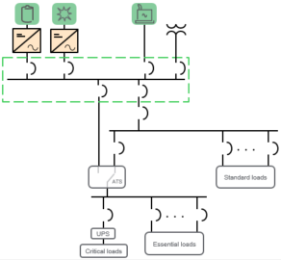
Microgrid Node – MV System
Metal Clad
. . .
. . .
Essential loads
Standard loads
Of course, many systems are MV mains composing a system of microgrids with MV “metal clad” and multiple LV substations.
And CHP is common in these cases for pharma, industry and commercial customers.
LV ECC
Notes:
For many campus style microgrids (i.e. military bases), it may make sense to have building level microgrids on the most critical buildings, analogous to having a UPS on a building’s most critical loads.
In some cases, the most likely cause of an outage is within the power distribution system on the campus.

Slide 18
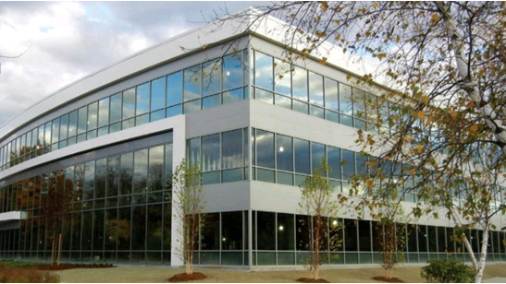
Boston One Microgrid Technology - Example
Also in a new business model - “Energy as a Service” or “PPA” for the microgrid.

Slide 19
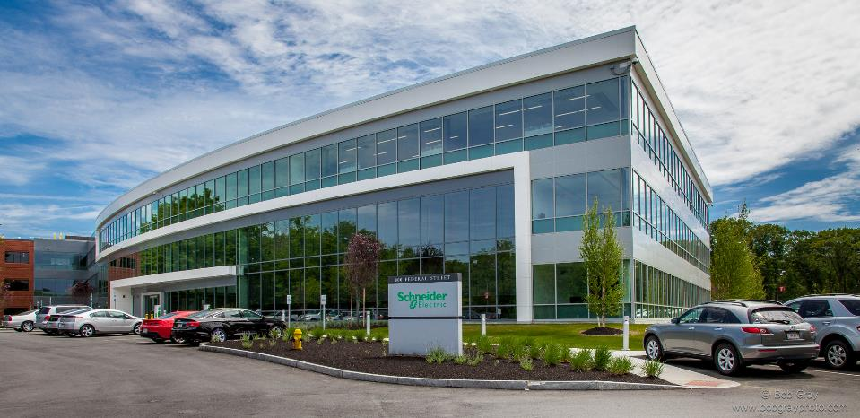

Boston One Campus or “BOC”
Campus Stats:
240,000+ square feet
Serves as North American HQ
3 Building Campus
750 + employees
1 of 5 Global R&D Centers
Microgrid Technology Example – and Energy as a Service (EaaS)

Slide 20
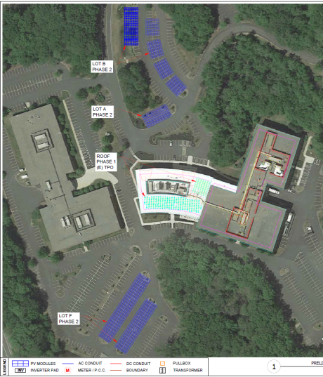
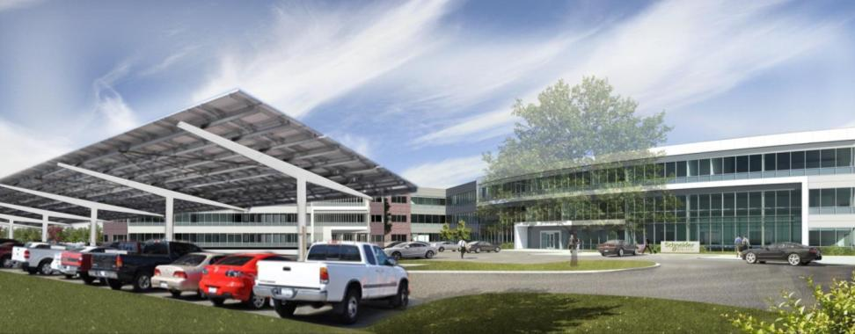
Energy as a Service – in a “PPA” or “ESA” about $ .16 kWh
Distributed Energy Resources:
375 kW PV (rooftop and carport)
400 kW natural gas generator (existing)
Load Control:
Schneider Electric Building Management System
Fast load shedding (via Masterpact breakers)
Electric Vehicle charging stations

Slide 21
BOC – Initial State
Key factors:
Regular outages since moving into new building
Existing data center and UPS
Total load ranges from ~350kW to ~1.5MW
Existing 400 kW gen-set feeds critical load through an Automatic Transfer Switch (ATS)
Stranded gen-set capacity: > 300kW during outages
Potential for Solar PV that will save $ for the campus ($.09 vs. $ .15 - $ .17/kWh
National Grid
2000 kVA transformer
3000A Masterpact
. . .
. . .
400kW
genset
480/277V and 208/120V loads
480/277V and 208/120V loads
Underserved “standard” and “essential loads”
ATS
Data Center / critical IT loads (≤100 kW)
Critical loads

Slide 22
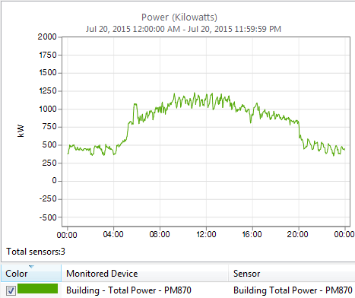
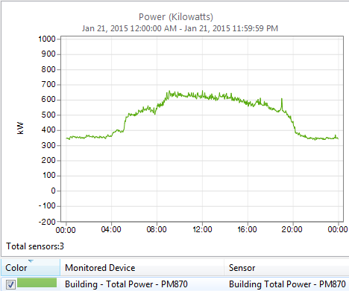
BOC can operate from a single National Grid feed (2 MVA each), but could not have “business as usual” with just our 400 kW genset
Representative summer day: 1.25 MW peak
Representative winter day: 0.67 MW peak
PV size comment

Slide 23

National Grid
BOC Microgrid
at 6-Apr-2017 Unveiling
2000 kVA xfmr
3000A Masterpact
. . .
. . .
400kW
genset
480/277V and 208/120V loads
480/277V and 208/120V loads
ATS
375 kW
Energy Control Center
Actual controls
S1
S3
Data Center / critical IT loads (≤100 kW)
S2
L1
L2
~300 kW stranded gen-set capacity no more
Up to 675 kW of Essential Loads being served

Slide 24
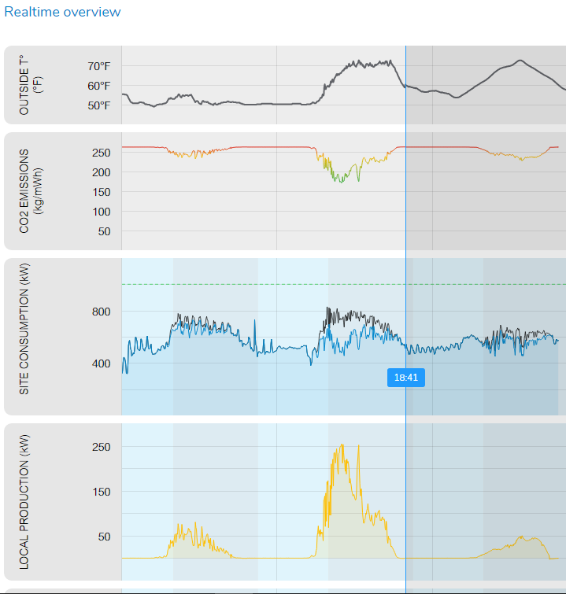
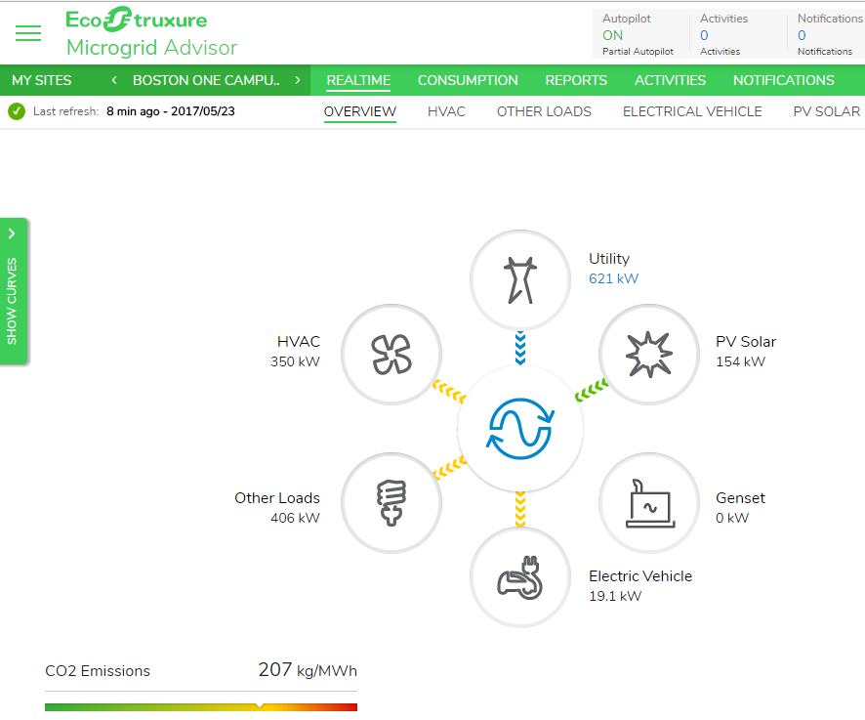
BOC - EcoStruxure Microgrid Advisor
Monitoring and Control to Optimize ROI and Sustainability
actual
forecast
Historical and Forecasted Values

Slide 25
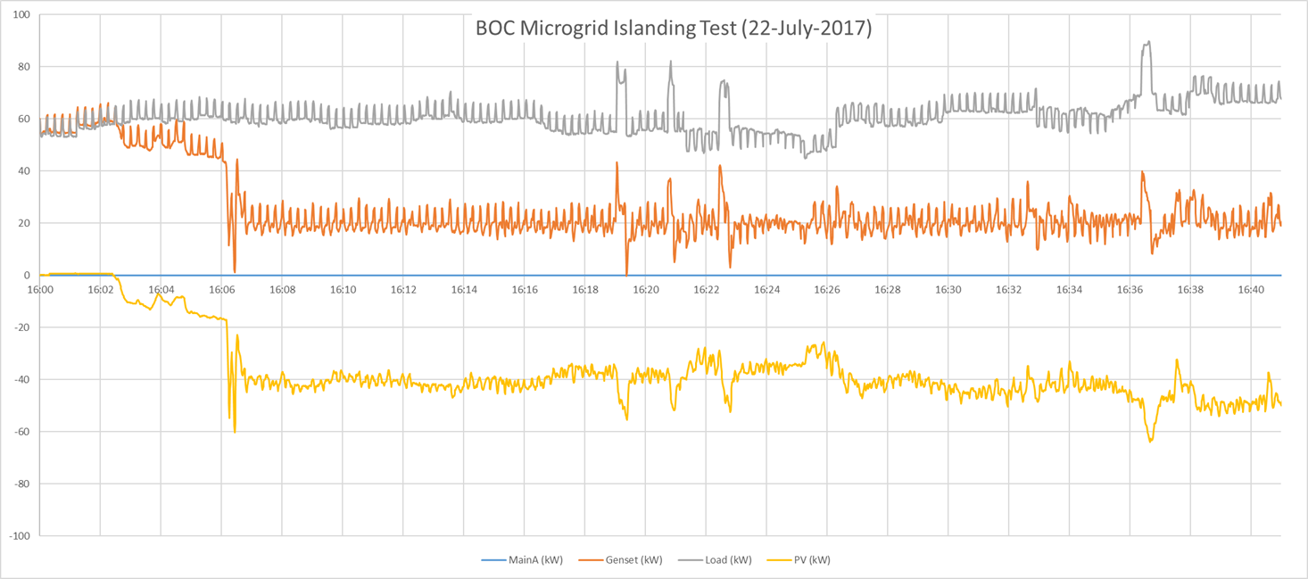
Gas Genset as the Anchor Resource for PV:
Load
400 kW Kohler gas genset
Solar PV – shown as negative
In island mode, the gas genset and PV output are controlled by the edge (microgrid) controller. Saves fuel in island mode, as inverter carries about 2/3 of the load; and genset carries 1/3 of the load. There is no battery energy storage needed in this example. Load step change management is also facilitated by the controller which sequences certain loads, and also can lock out or load shed – load add as needed to keep stability in island mode.
Notes:
In island mode, the gas genset and PV output are controlled by the edge (microgrid) controller. Saves fuel in island mode, as inverter carries about 2/3 of the load; and genset carries 1/3 of the load. There is no battery energy storage needed in this example. Load step change management is also facilitated by the controller which sequences certain loads, and also can lock out or load shed – load add as needed to keep stability in island mode.

Slide 26

Update - ECC with Dispatchable Galaxy UPS
Energy Control Center
. . .
. . .
Note: ECC circuit breakers are typically smart and electrically operated
Essential loads
Standard loads
Galaxy UPS
Legend:
AC Bus
DC Bus
Critical loads
Notes:
This slide expands on the previous one by including a dispatchable Galaxy UPS. A dispatchable UPS can help with peak shaving or with demand response when properly controlled.
As one builds the slide (i.e. by right clicking), the BESS disappears, in order to illustrate that perhaps all/most of the functionality of the BESS can be achieved by the Galaxy UPS.
The second build (i.e. right click) shows that the UPS’s bypass breaker can potentially be used to allow the UPS to feed some Essential/Standard loads if the UPS has available capacity.

Slide 27
Deeper Dive: Microgrid Solutions from Schneider Electric

Slide 28
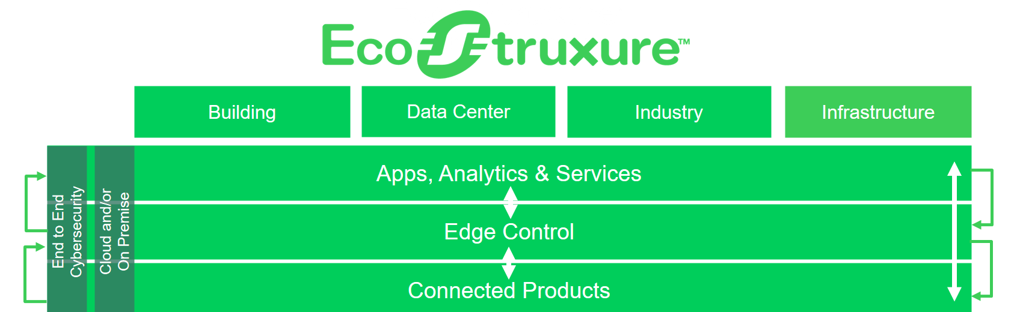
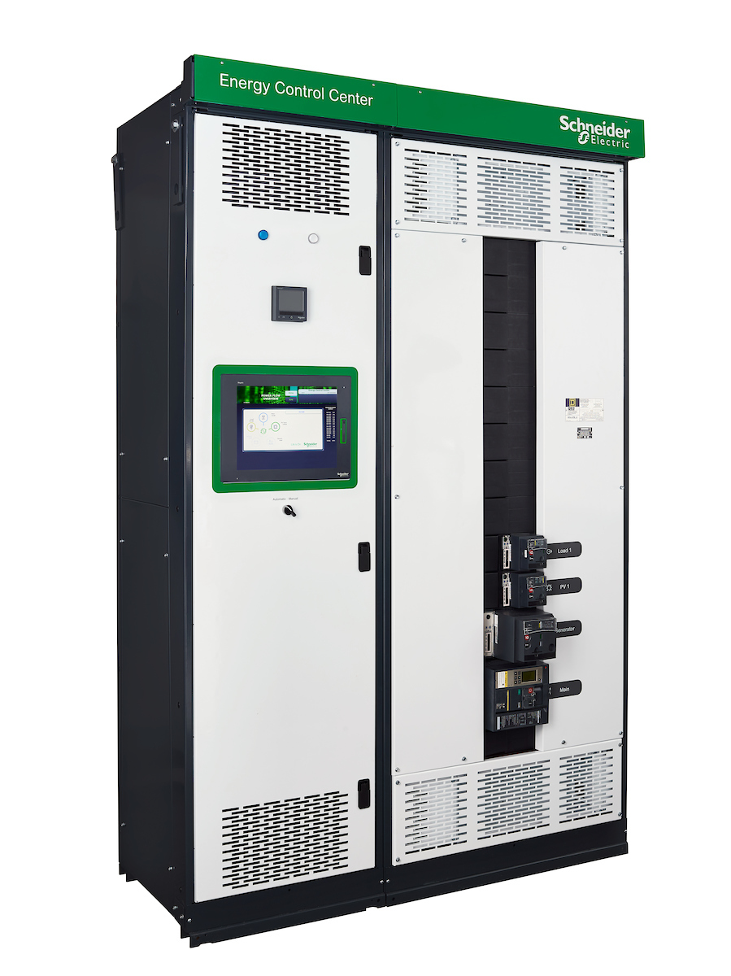



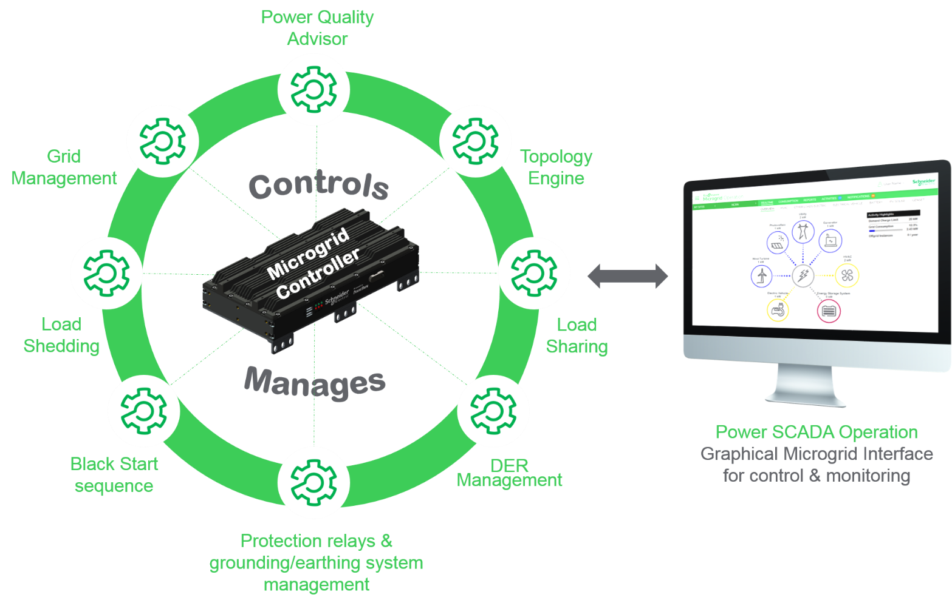
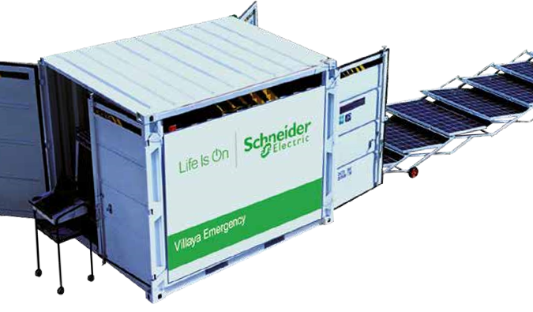
Microgrid Solutions:
Microgrid Feasibility Studies
Deep analysis and insights from experts leveraging proprietary algorithms to recommend ideal microgrid structure and layout, size, costs and potential challenges which de-risk project during detailed design and implementation
(optimize type, size and mix of DER)
Energy Control Centers integrates DER into an intelligent, pre-engineered, and configurable power control center to
optimize resources and maximize
facility performance
EcoStruxure Microgrid Advisor
demand-side energy mgmt. platform automatically optimizes DER operation. Economic optimization in grid tied mode, with build in weather, source, and load forecasting. Machine learning features.
Battery Energy Storage Systems hardware solution offers best-in-class energy density, footprint and efficiency to meet applications from industrial to commercial
EcoStruxure Microgrid Operation
One of Schneider Electric’s microgrid controller solutions providing network, generation, and protection management for microgrid safety, stability, optimization and efficiency
Villaya Emergency Microgrid Solution
hybrid mobile microgrid that supports clean and cost effective solar and storage for emergency response
Page 28
#EcoStruxure

Slide 29

Microgrid Control Architecture follows our EcoStruxure Platform
EcoStruxure Platform
Building
Data Center
Industry
Grid
Apps, Analytics & Services, i.e. EcoStruxure Microgrid Advisor
min
Sec/ms
ms
Edge Control, i.e. M580 or EcoStruxure Microgrid Operations
End to End Cybersecurity
Cloud and/or On Premise
Connected Products, i.e. Smart Breakers, PV inverters, meters
Notes:
JPT Talk Track:
(Connected Products)
However, there are some things that don’t change.
Everyone is talking about the Internet of Things. But IoT starts with Good Things, Excellent Things, World-Leading Things. These don’t change.
When our customers come to see us they are not coming to look at the Internet, they are looking for the best breakers, sensors, actuators, motor drives… they come for the best products in their categories. These do not change.
So IoT starts with the best products and the best things and only then can they be connected.
---------------------
(Edge Control)
We at Schneider Believe that our customers drive mission critical applications. They need the applications to run even if the networks are broken or even if the software/analytics on the other side of the planet is not working. Whether it is at home or a hospital or production line – we do not want an outage.
So we want controls that can work locally with autonomy and operators must be able to take over the operations if there is a problem. Everything cannot be remote. Local control is a must. Control of devices at the Edge of the network of things is a must.
We bring to our customers one control platform that enables one ‘programmation (program)’, one design, one commissioning, one monitoring. So our customers have less complexity to manage at this level.
In summary , Edge Control is a converged control architecture by application with principle of “Local First” supporting autonomous, operator overridable, firewall from network which serves multiple end user segments
----------------------
(Apps, Analytics & Services)
And probably the biggest change for us in the past 5 years is the development of a full portfolio of software, apps, and analytics to permit, enable and catalyze optimization.
This layer is hardware agnostic. We know that our customers come with a variety of hardware and systems. Our Apps, Software and Analytics work with any hardware, any systems , any control.
-----------------------
EcoStructure platform enables EcoStruxure as the technology backbone and is Secure, Open, Scalable
-----------------------
(Cyber Security)
We have the good guys and the bad guys in this world and we have to protect our systems from the bad guys. So it has to be fully cyber-secure.
(Cloud/On Premise)
Our customers also want to maintain control over what data they want on the cloud and what they want to keep on premise. So any software or analytics we produce should be operable on premise and in the cloud. Cloud and/or On Premise as an open system provides big data aggregation, sharing, new analytics and services

Slide 30

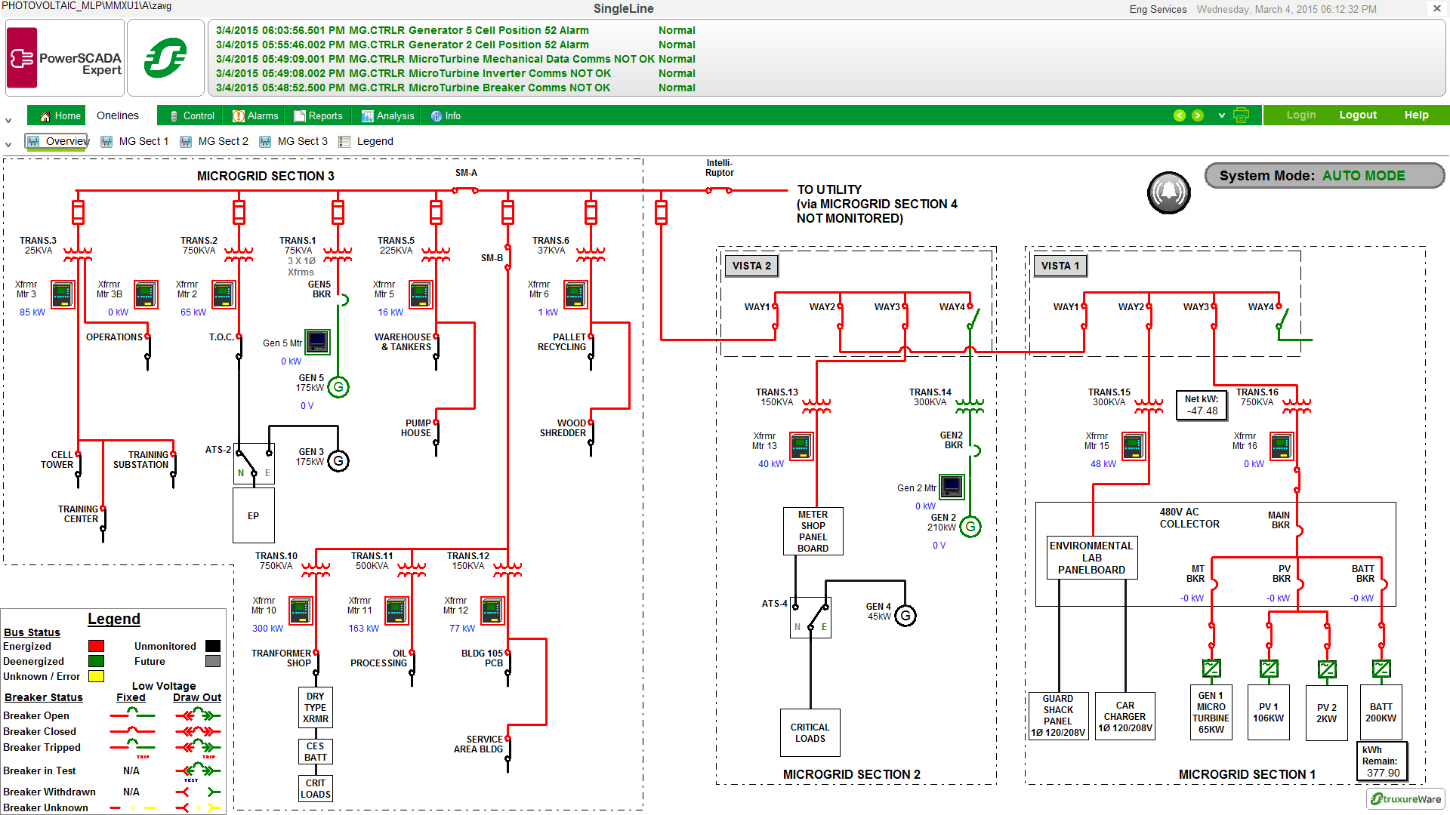
Microgrid “Edge” Controllers & Software
Manage island mode, trnasitions, and optimize DER when grid tied
Use Cases / DER
Sharing strategy | Aim to maximize renewables consumption within the microgrid
ATO Automatic Transfer Operation | Automatically manages connection / disconnection from the grid
Load sharing | Assure the stability for the tension and frequency by balancing the production and consumption in real time
Load shedding | Cut-off non-priority loads when the production can not reach the consumption
Relay Settings | Manage the protection relays and if needed the global system protection when islanded
Connectivity | Modbus and Modbus TCP IP, IEC 61850
Notes:
At the application/analytics layer, EcoStruxure Microgrid Advisor provides the intelligence and control to address a highly variable environment.

Slide 31

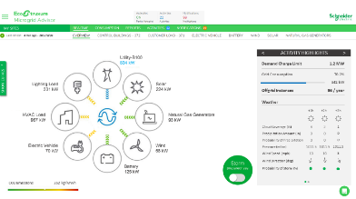
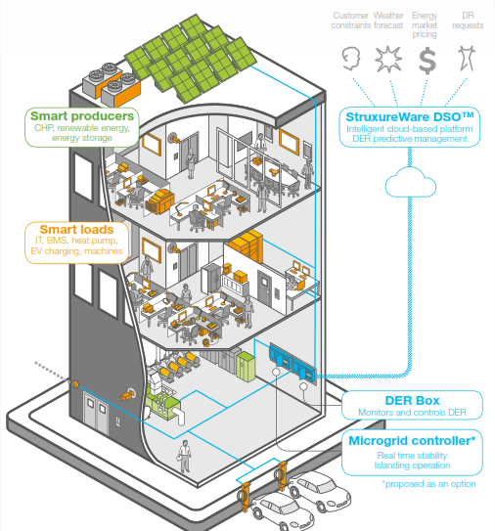
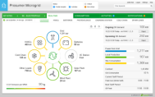
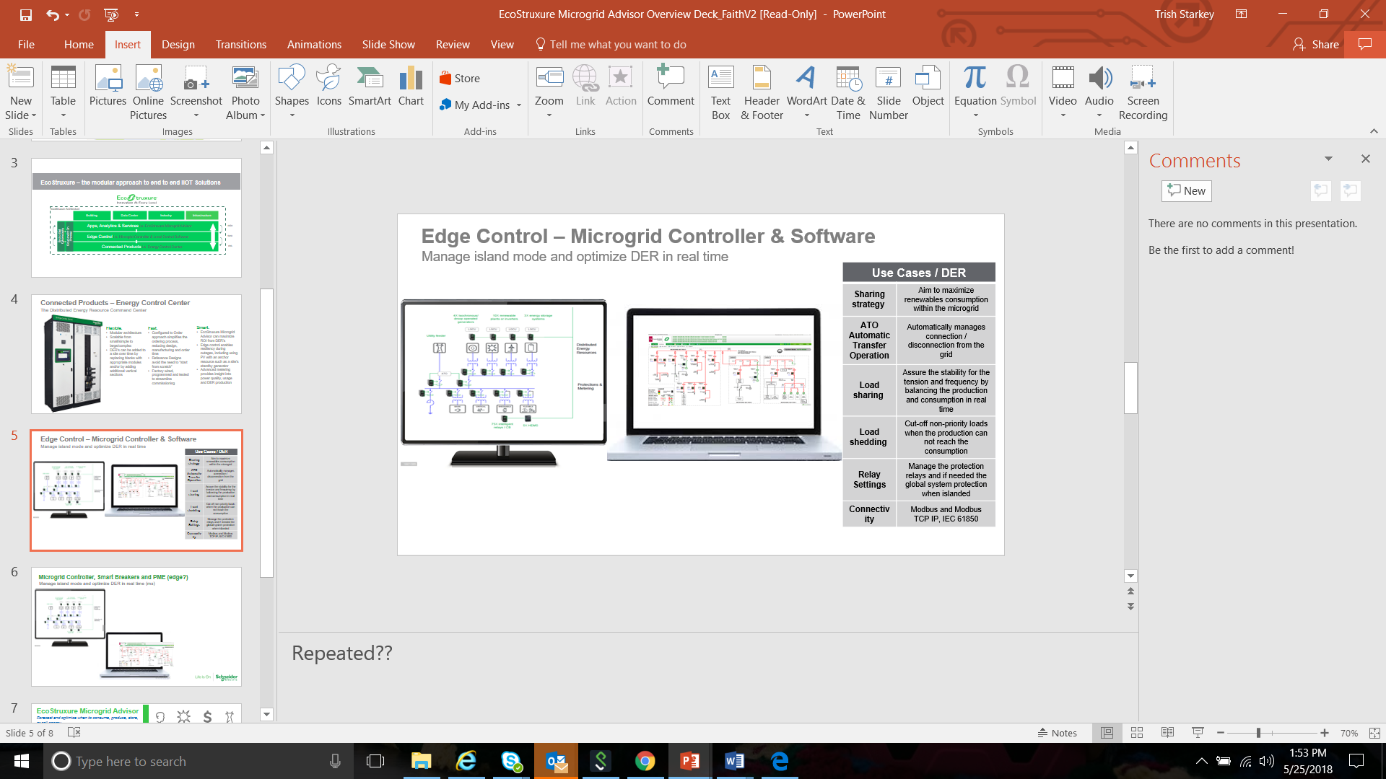

Apps, Analytics & Services: EcoStruxure Microgrid Advisor
Customer constraints
Weather forecast
Energy market pricing
Demand response requests
EMA
ECC
Confidential Property of Schneider Electric |
Notes:
At the application/analytics layer, EcoStruxure Microgrid Advisor provides the intelligence and control to address a highly variable environment.

Slide 32

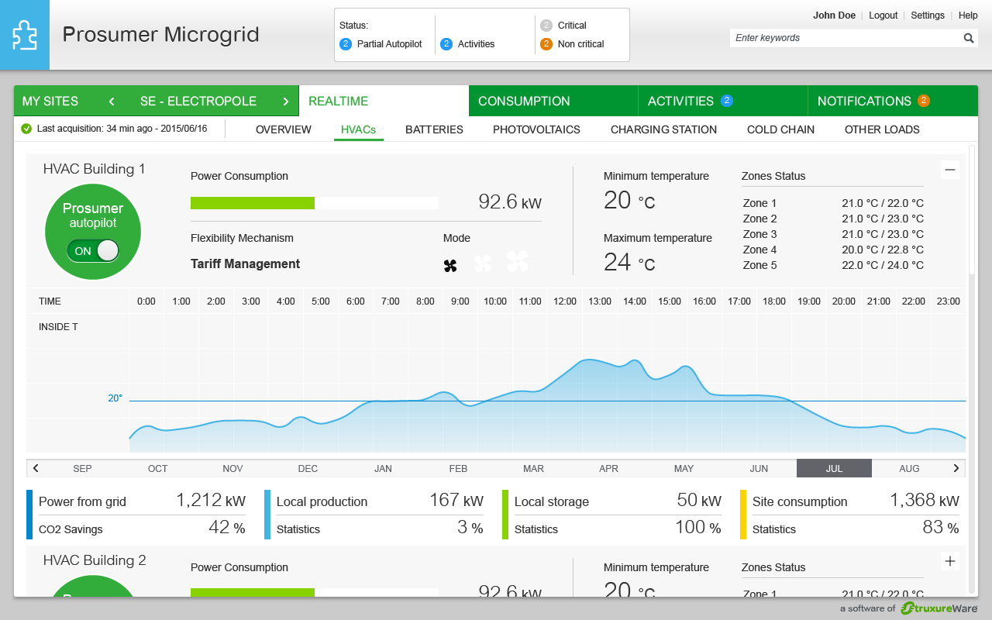
EcoStruxure Microgrid Advisor
Optimization Software for Economic Dispatch
DER Monitoring, Control & Autonomous Optimization
    Web accessible, multi-stakeholder dashboards
    Forecasting of renewable production, load, and price data
Tariff Management
    Consume or produce energy at the most advantageous time based on variable utility rates
Automatic Demand Response & Control
    Reduce peak demand charges
    Partner with curtailment service providers for grid services
Self Consumption & Island Mode
    Toggle from economic optimization to resiliency storm mode
Notes:
Updated every 5-10 minutes
Accessible from anywhere
Snapshot of onsite DER activity and key metrics under Activity Highlights
Utility feed and multiple DER visibility with real-time overview of kW generation / load
CO2 Emissions tracking
Easy to dive into specific DER for additional details

Slide 33

Eco. Microgrid Advisor works with onsite Controls
Client
Constraints
EcoStruxure Microgrid Advisor
Predictive DER management
Forecast when to produce, store or sell energy
Data storage and reporting
Cloud-based accessible from anywhere
Interfaces with energy markets
Weather forecasts (DTN)
Weather forecast
Energy market pricing
Cloud
Demand response requests
EcoStruxure Microgrid Operation
(edge controller)
Reactive DER management - milliseconds
Ensures microgrid real time stability & reliability
Controls to connect/disconnect from the grid
Optimize energy production & use
Microgrid Campus
#EcoStruxure #Microgrid
Notes:
EMA cloud based
EMA or DER Box connects with onsite Microgrid Controller or SE Energy Control Center
EMA can also connect directly to onsite DERs
Controller manages real time reactive control. EMA bring predictive capability, with 48-72 hours of “recipes: in case communication is ever lost.
Control hardware: ECC with M580 or M340 common, centralized or decentralized, (multi processors, remote drops)
Also Micom 264 RTU good for fast load shedding

Slide 34
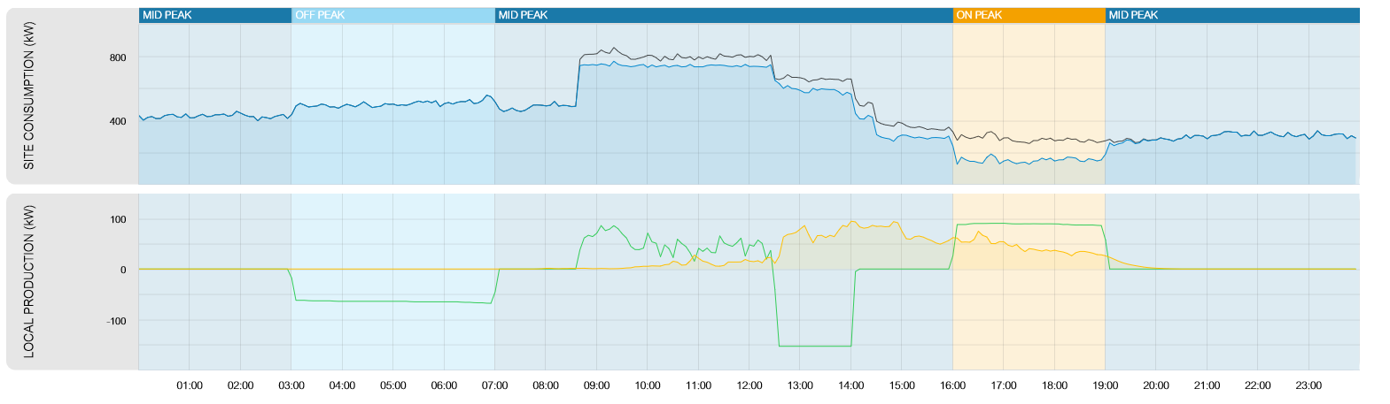
Time of Use, Self Consumption
Shift consumption from times of high cost to times of low cost
Solar PV
Battery Storage
Actual KW
Forecasted kW
Example 1: charge an energy storage system during “off peak” period and discharge it during “on peak” period
Example 2: consume energy with HVAC during “off peak” period (pre heating or pre cooling) and coast to reduce energy consumption during “on peak” period
Source: Oncor – May 27, 2015

Slide 35
Demand Management
Minimize costs by shaving peak demand
Solar PV
Battery Storage
Actual KW
Forecasted kW
Example 1: dispatch energy storage to supply some load to avoid a peak
Example 2: shed loads (HVAC, EV Chargers, etc.) to avoid setting a peak
Example 3: Sequence the start of large loads/processes to avoid coincident peak demand
Source: Oncor – May 27, 2015

Slide 36
Energy Control Centers
Bringing down the cost, customization and time required to implement microgrids

Slide 37
Energy Control Centers
Future Ready Distributed Energy Resource Command Center
Flexible.
Modular architecture
Scalable from small/simple (i.e. 50 kW, 1 DER) to large/complex (i.e. 1.5 MW, multiple DER’s)
Customers with a real estate portfolio can use 1 or 2 sections for their small/simple sites and multiple sections for their large/complex sites
DER’s can be added to a site over time by replacing blanks with appropriate modules and/or by adding additional vertical sections
Fast.
Configured to Order approach simplifies the ordering process, reducing design, manufacturing and order time
Reference designs avoid the need to “start from scratch”
Factory wired, programmed and tested to streamline commissioning
Smart.
EcoStruxure Microgrid Advisor can maximize ROI from DER’s
Edge control enables resiliency during outages, including using PV with an anchor resource such as a site’s standby generator
Advanced metering provides insight into power quality, usage and DER production

Slide 38
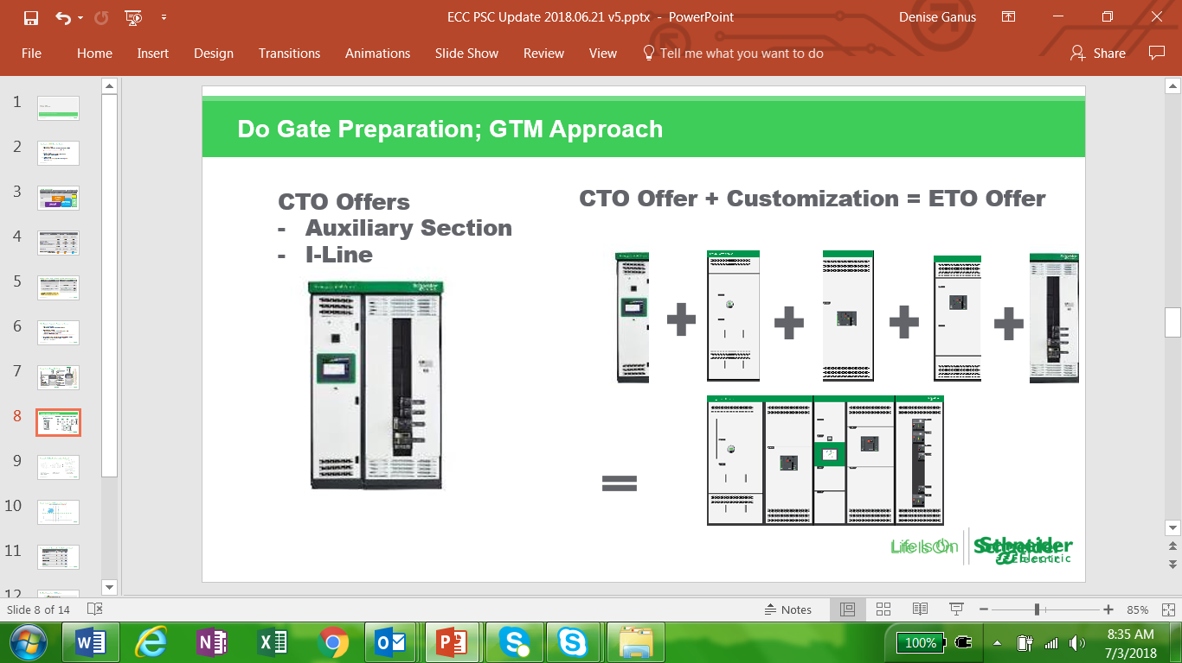


Energy Control Centers – Sizes less than 800 A to 5000 A per line up
Primary GTM: MGCC / EPCs, Specialists
*Projects prescribed via MGCC
Price
Primary GTM: MGCC / EPCs, Specialists
*Projects Bid via MGCC
Primary GTM: Consultants/ Distributors/ Selected Partners
ECC 1600/2500
Platform: QED2 1600-2500 Amps (+opt up to 3000A)
Generator and/or Battery Storage anchor
Islanding
Load management
Multi source management
+Fast Separation from utility and fast load shedding
+Custom protective relay for local utility interconnection requirements
ECC 800/1200
Platform: IPaCS 800 – 1200 Amps
Generator or Battery Storage anchor
Islanding
Load management
Multi source management
100 to 500kW
Small/Medium Building
Large Chains / Strategic Accounts
Brown/Greenfield
500kW to 1.5MW
Medium/Large Bldg. w/ multiple DERs
Across Segments
Brown/Greenfield
500kW+ w/ complex use cases
Medium/Large Bldg. w/ multiple DERs
Across Segments
Brown/Greenfield
Complexity

Slide 39
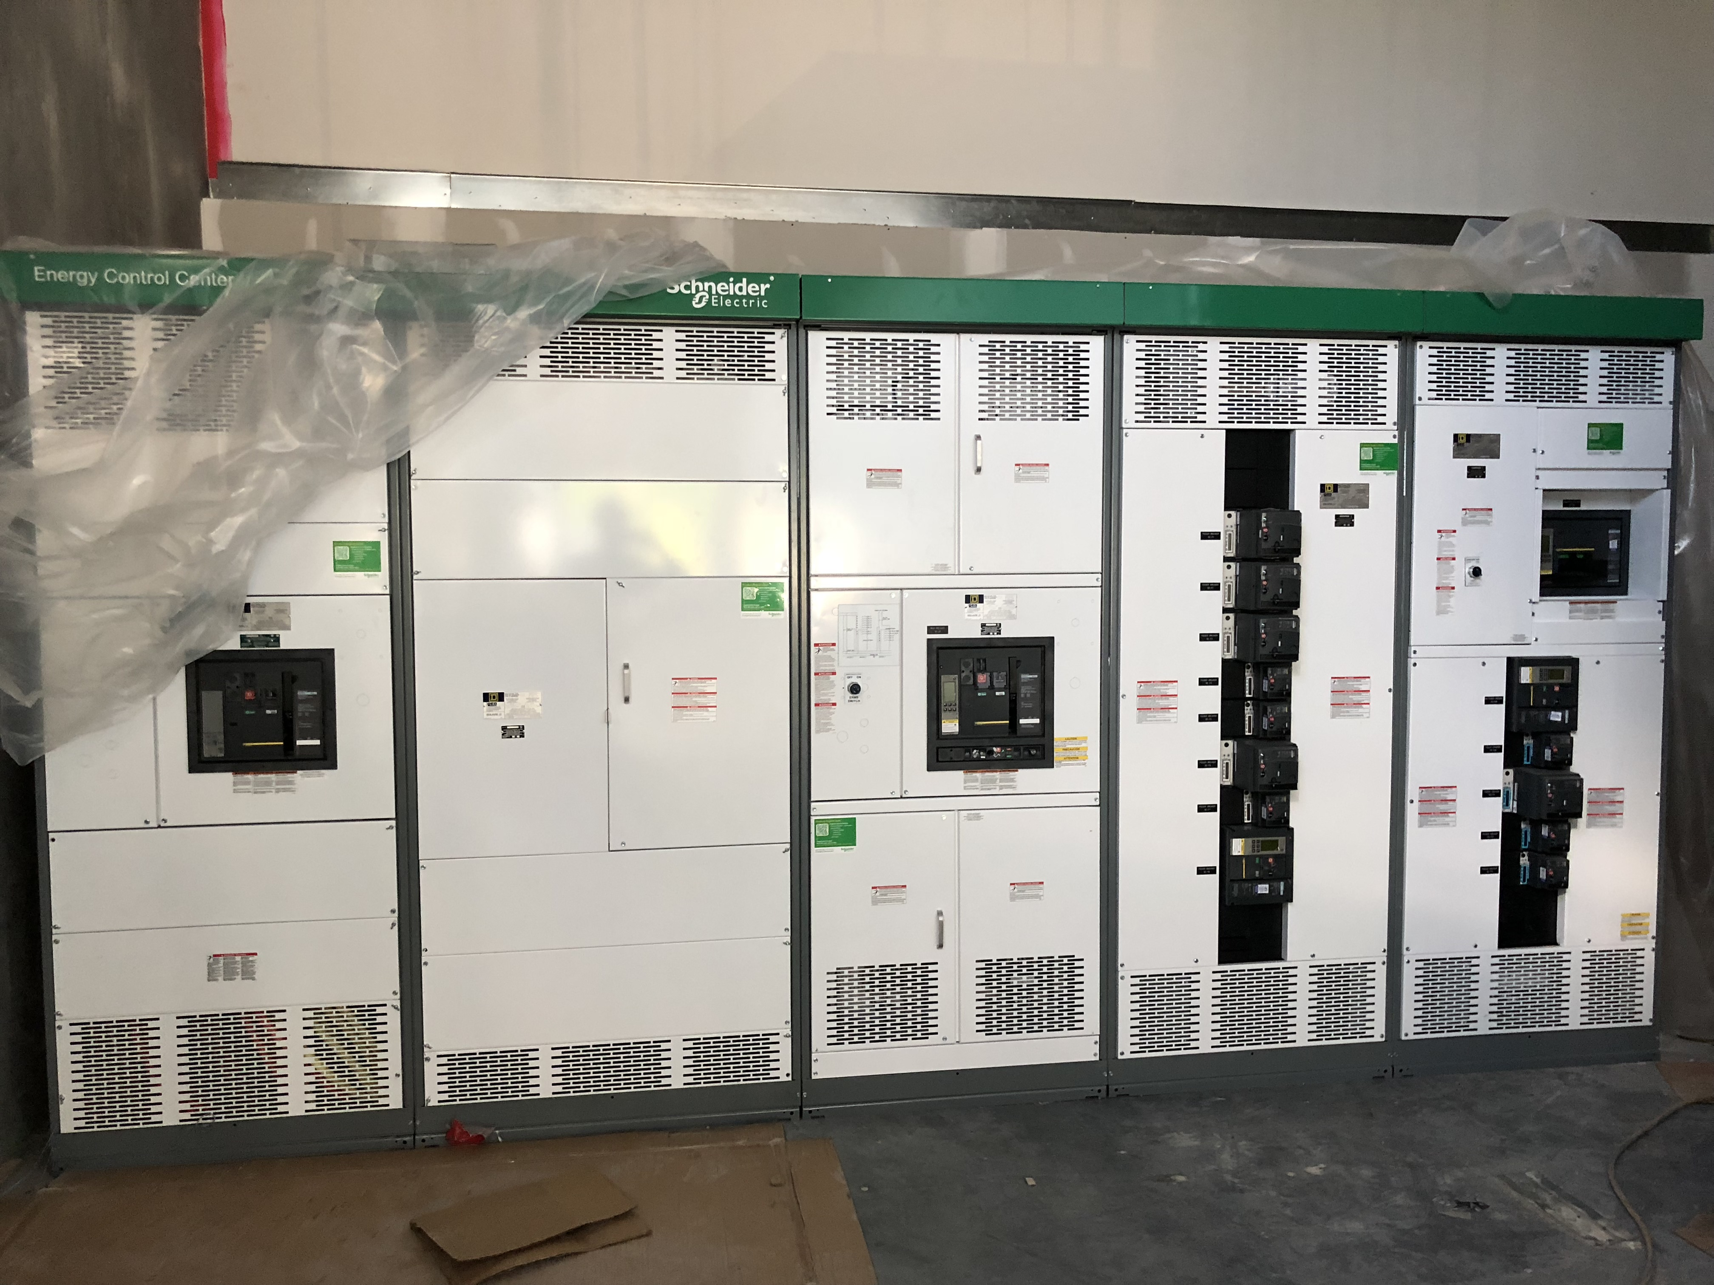
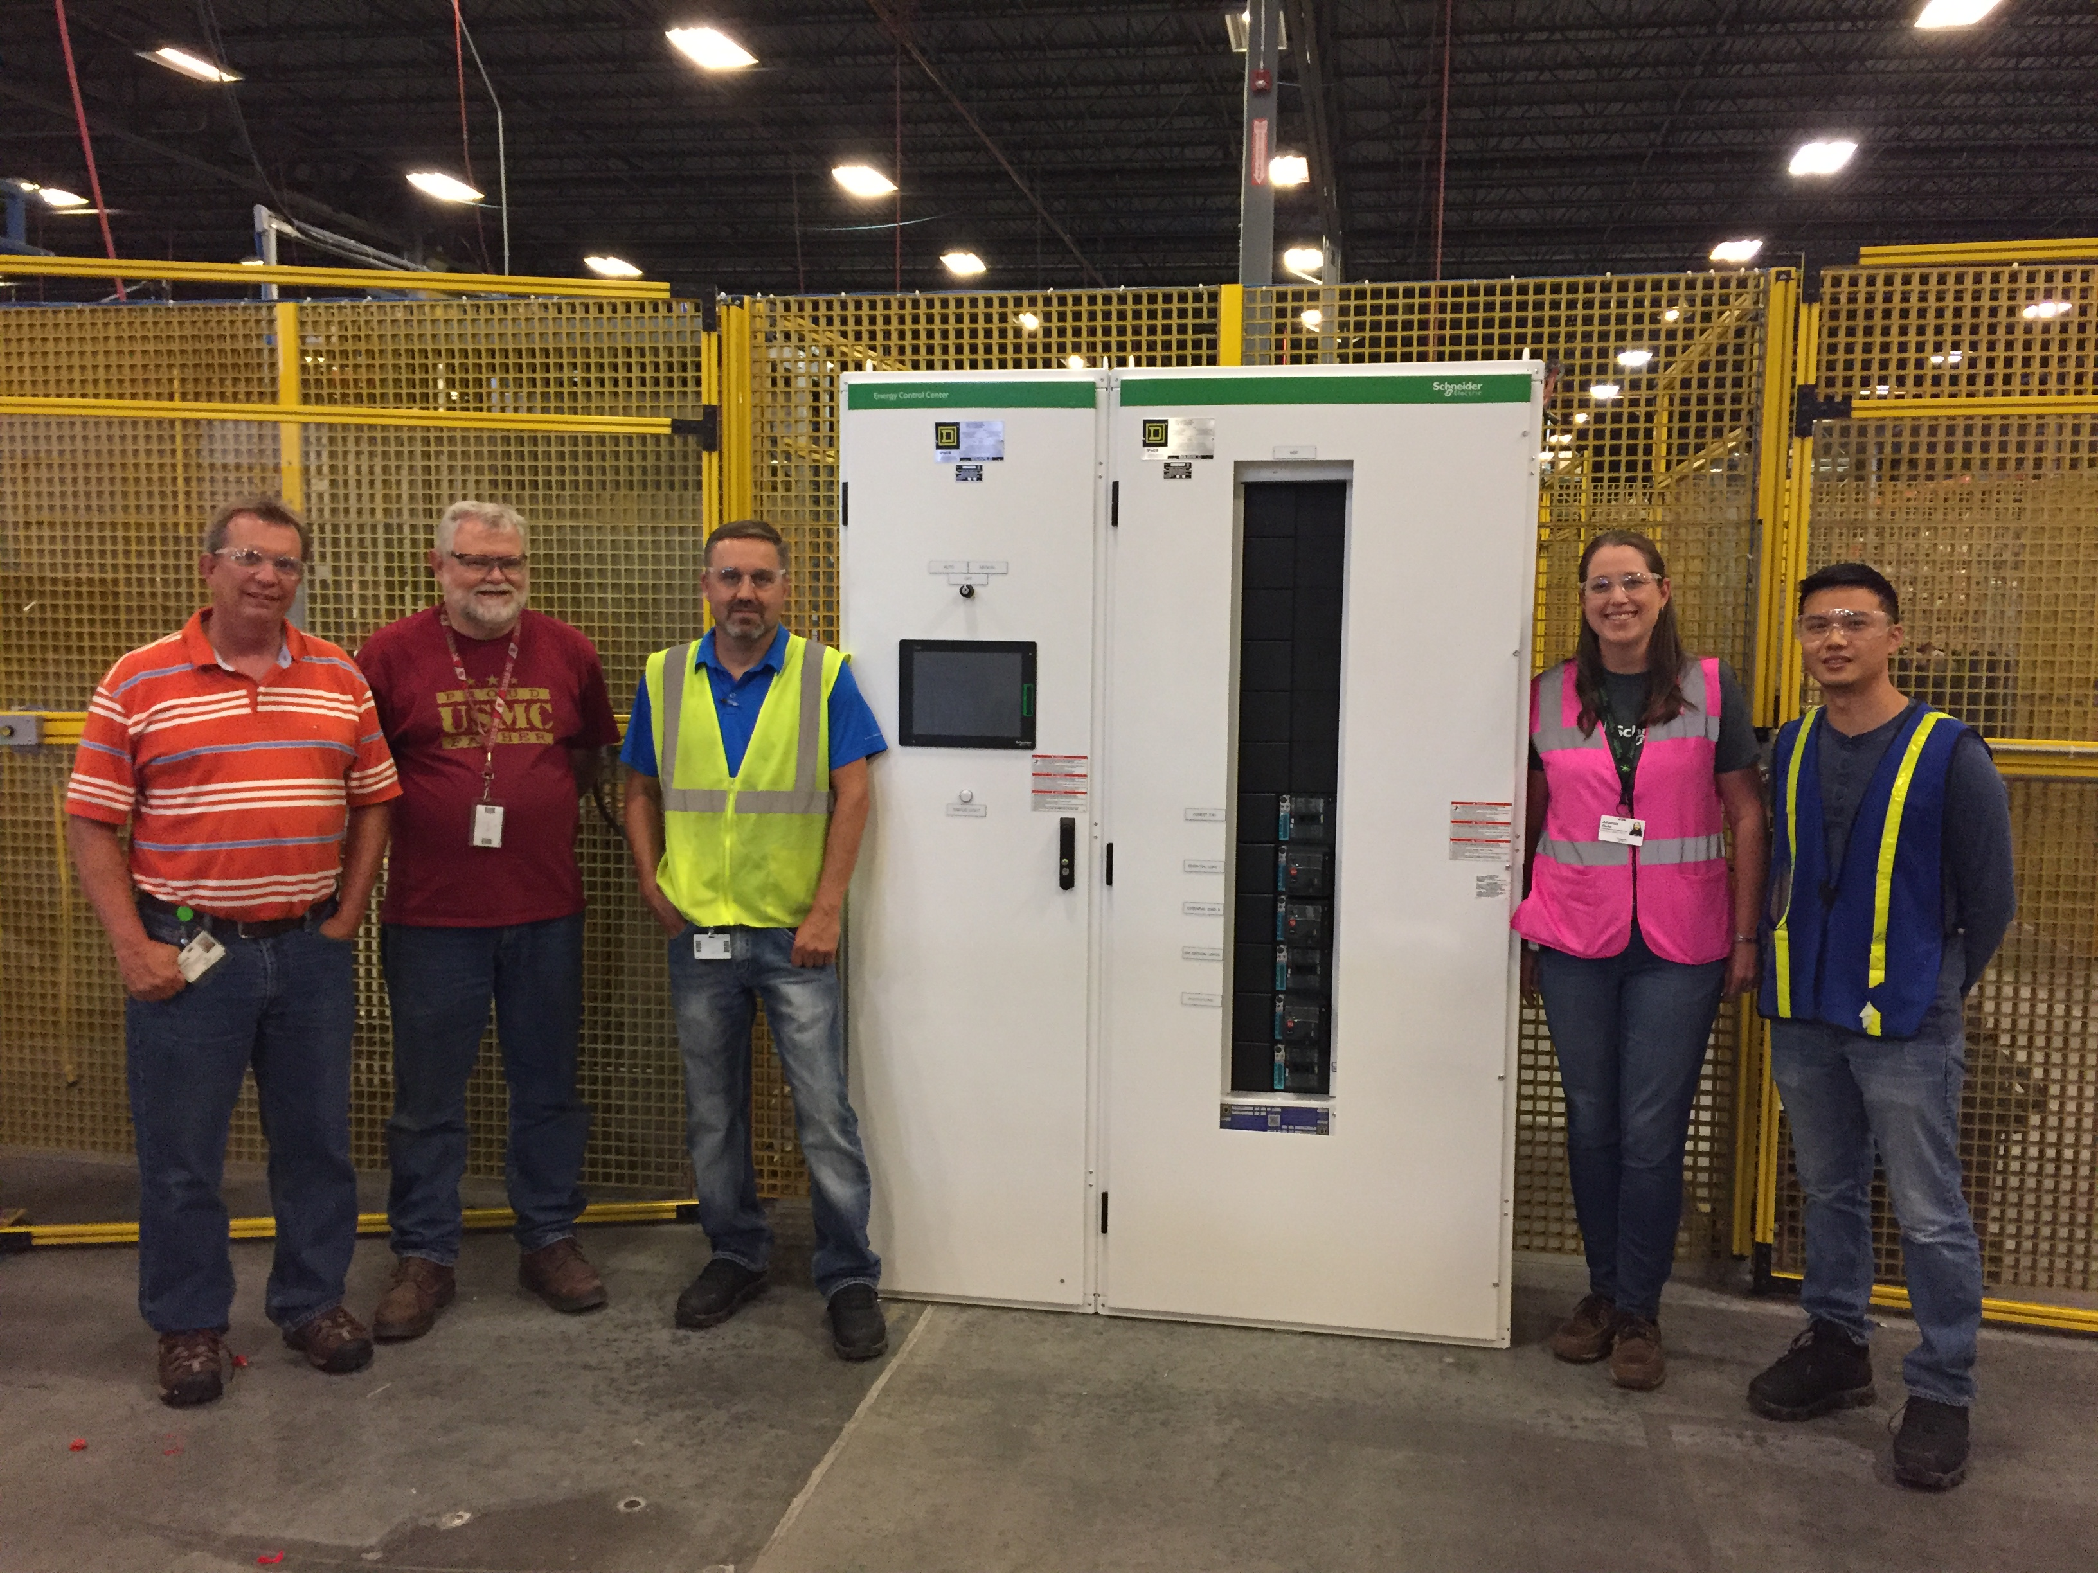
Some pictures of different Energy Control Centers

Slide 40
Battery Energy Storage System (BESS)
125 kW to > 2 MW, 1 – 4 hours or more
Schneider Electric’s BESS hardware solution is best-in-class in terms of energy density, footprint and efficiency.
Coupled with Schneider Electric’s intelligent and dynamic control system, EcoStruxure Microgrid Advisor (EMA), Schneider Electric’s storage solution and power distribution can meet all your storage needs for commercial and industrial applications.
Less than $ 50,000 per 100kWh includes inverters, batteries, NEMA 3R/4 containerization, cooling, monitoring and control, and fire suppression
Grid forming and grid following capable

Slide 41







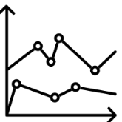

DER & Microgrid Development
Iterative process
Concept Design
Financial Modelling
Development
Contracts
Load profiles are created
Customer goals are defined
Tariffs, incentives evaluated
Interconnect process mapped
Sequence of Operation (SOO)
Schedules created
Financial model to be developed based on customer load requirements and goals
Agreements are developed based on customer needs and financial requirements
Select vendors and execute contracts for DER, EPC, PPAs, SOWs and guarantees as needed
Use Cases
Specific use cases are developed
Use Cases
Configuration
Integration Testing
Commissioning
Deliver and install DER solution at customer site
Initial configuration is completed
Testing of initial configuration by using pre-developed use cases
Finalize commissioning of the DER solution
Interconnect the DERs
Analytics and Reporting
Operation, Maintain, Optimize
Advanced analytics framework provides detailed reports outlining DER performance and facility load metrics
Begin metering and verification, maintenance and optimization as needed

Slide 42
DER | Real Estate need ft² / kW | Energy kWh/year | ~ CapEx $/kW all in before incentives
Solar PV – rooftop, ground mount | 100ft² (>3.5 acre/MW) | 1MW = 1.5M kWh/year* | $ 1,200 - $ 2,250 above 300 kW size
Solar PV - Carports | 100ft² (>4.5 acre/MW) | 1MW = 1.5M kWh/year* | $ 3,750 above 300 kW size
Wind ** (2MW turbine) | 75ft² (.75 acre/MW) | Varies geographically | $2,500 above 1 MW
ES – Battery (Li-Ion chemistries) | ~3MW per 40’ shipping container | 90% round trip efficiency | $450 - $1,200 with cooling, NEMA 3R, controls
CHP (LNG, biogas +) | W 3M x H 3M x D 6M (Caterpillar 3512C 1200-1500 kWe) | 7.84 MWh @ 90% avail. Per MWe | $ 2,000 - $3,000 all in, incl heat recovery above 1 MW
Microturbine (LNG, biogas +) | W 3M x H 3M x D 9M (Capstone C 1000 1 MWe) | 7.84 MWh @ 90% avail. Per MWe | $ 2,600 - $3,500
Fuel Cell (LNG, biogas +) | W 3.3M x H 3M x D 8.7 M Doosan Pure Cell 400 kWe*** | Similar to microturbine | $ 7,000 - $ 9,000 may be CHP as well
Genset (Diesel/NG) | W 3M x H 3M x D 6M (Caterpillar 3512C 1200-1500 kWe) | back rating vs. continuous? Air quality ratings | $400 - $600 prime mover, $ 1,000 all in

Slide 43
Microgrid Project Feasibility Examples

Slide 44
Approach and Summary Results – ABC CAMPUS CHP
Reviewed Customer Information
  XXX Steam and Electrical Studies
  Interval data
  Electric bill and natural gas cost summaries
  Air Permits
Reviewed Four Steam System Options
  Options 2-4 proposed 3.3-5MW of onsite generation at central plant
Proposed an “Option 5” microgrid with distributed CHP instead of central steam plant expansion
  Allows for onsite generation to better match campus load: 10-20MW
  More efficient heat recovery and avoid more capital costs while satisfying future load growth
  Existing boilers are still operable or may be replaced in existing steam plant as necessary
Analyzed Electrical System Upgrade Concepts and Cost Estimates
  Additional scope may be required to integrate onsite generation or to “Island” during grid outage
Analyzed Four Steam System Options for Sustainability Impact
  Significant GHG reductions for CHP systems with high heat recovery

Slide 45
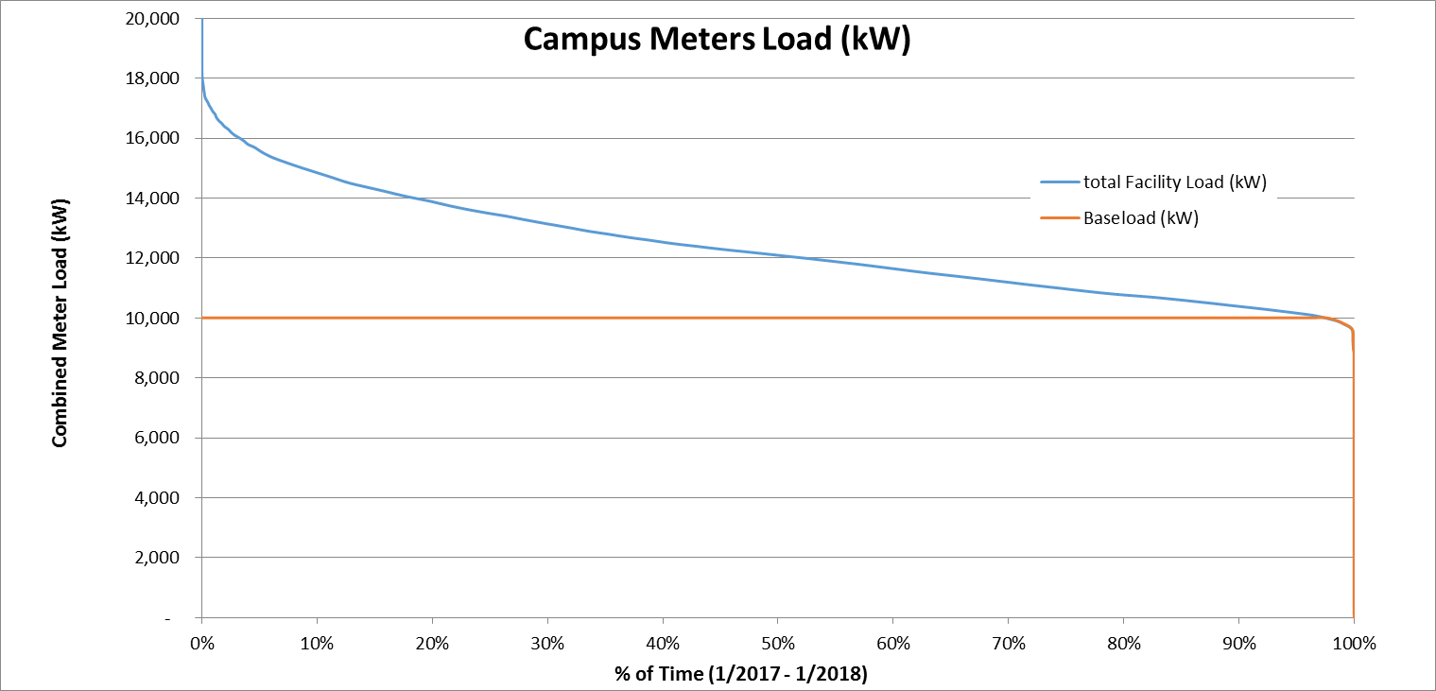
Option 5 Concept: Microgrid System with Distributed CHP
Load Duration Curve
Options 2-4 limited to 3.3-5MW generation at XXX Substation/Central Plant
Onsite generation/CHP is limited by load at each substation that the CHP is tied to
Campus baseload is 10MW; peak load 18MW
Future peak load est. to be 21.1MW (electrical system study)

Slide 46

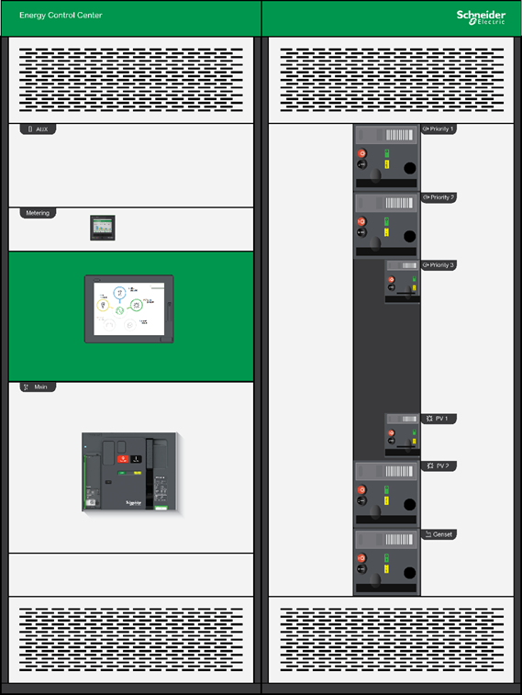
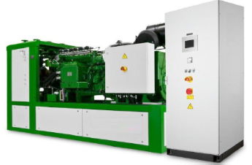
Option 5 Concept: Microgrid System with Distributed CHP
Energy Control Center
Combined Heat and
Power System
Future
Renewable
Energy
Sources
HRSG
LV output
Solar PV
Storage
1,500-2,000 PPH per MW
of CHP nameplate
0 - 3.5MMBTU/h per MW
of CHP nameplate
150psi Campus Steam/Condensate
Backup Genset
Building Hot Water loop
(typically heated by campus steam loop)
Emergency, Critical and Non-Critical Facility Loads
Allows use of cost effective packaged CHP systems
More efficient heat recovery- closer to the heat loads
Avoid/delay expansion of central steam plant
  Steam consumption is reduced by recovering heat directly to the buildings’ hot water loops
  Steam load growth is satisfied by distributed CHP systems injecting steam into campus steam loop
  35MMBTU/h available from 10MW of CHP- equivalent of approx. 35,000PPH of 150psi steam
Offset electric usage from every substation, not just XXX
Works in conjunction with Option 2 or Option 4; system may also include generation from gas turbine or backpressure turbine

Slide 47
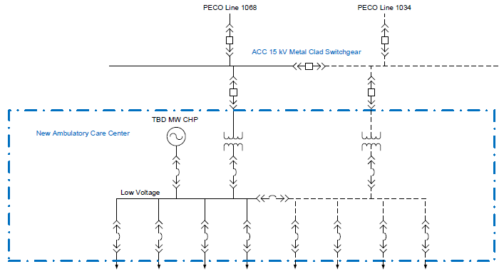
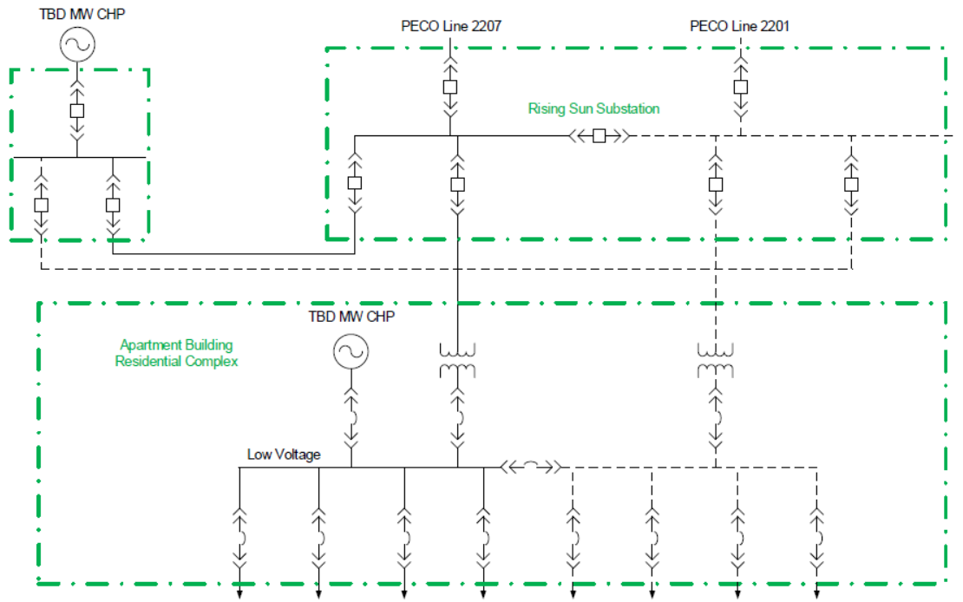
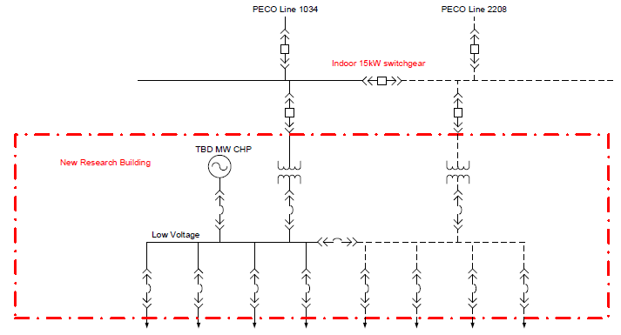
Option 5 Concept: Microgrid System with Distributed CHP
Electrical Tie-in
XXXX
ABC
MABC
Multiple ways to tie in CHP behind each substation
When replacing MV electrical gear, leave provisions for CHP tie ins.

Slide 48
Substations and Utility Services with Future Buildings
Feeder | Substation | Future Peak Load (MW)*
1068 | ABC | 3.5
2207 | SunXXX | 2.9
1034 | ABC | 5.1
2208 | MABC | 4.5
2201 | PABC | 5.1
* Per XX Electrical System Study, Figure 4-25
Packaged CHP systems may be installed at facilities with most addressable heat
Max. system sizes are determined by electric load at the substations
New facilities may be designed to include CHP for easiest system integration

Slide 49
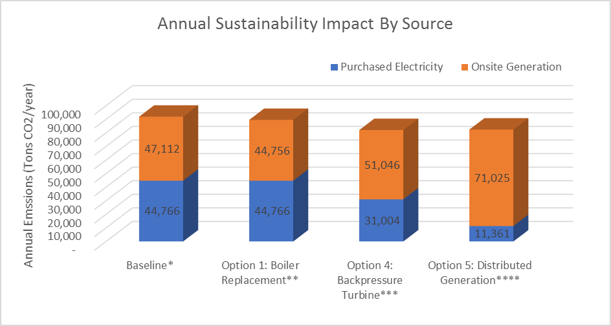
Impact of Sustainability/GHG Savings
GHG Equivalencies
 | # of Cars Removed from Road | # of Households’ Electricity Offset
Option 1: | 458 | 320
Boiler Replacement
Option 4: | 1,909 | 1,336
Backpressure Turbine
Option 5: | 1,844 | 1,290
Distributed Generation
www.epa.gov/energy/greenhouse-gas-equivalencies-calculator
Annual Cost to Offset Purchased Electricity with RECs
PA REC Price ($/MWh) | $ 8.00
Baseline | $ 864,000.00
Option 1: Boiler Replacement | $ 864,000.00
Option 4: Backpressure Turbine | $ 598,388.73
Option 5: Distributed Generation | $ 219,264.00
3% Emission Savings
11% Emission Savings
10% Emission Savings
Assumptions:
*Assumes boiler system is 76% efficient
**Assumes new boiler system is 80% efficient
***Assumes backpressure turbine avoids 15% of campus electric usage
****Assumes lean burn recip. engines operating at 92% capacity factor, with 80% of available heat recovered
Purchased Electricity: Assumes eGRID (EPA) subregion XXX east
http://www.srectrade.com/srec_markets/pennsylvania
Some additional savings possible for Option 5 by reducing use of diesel backup gens
Notes:
Sam- maybe include some metrics and graphics?
Equivalent cars taken off the road; equivalent trees planted? Good graphics from the EPA emissions tool
Maybe quantify the RECs like we talked about?
how much solar would it take to reduce that much CO2 if they were to try and build solar (which they don’t have space for)?
what the cost of RECs would be if they went that route to get the same sustainability result?

Slide 50
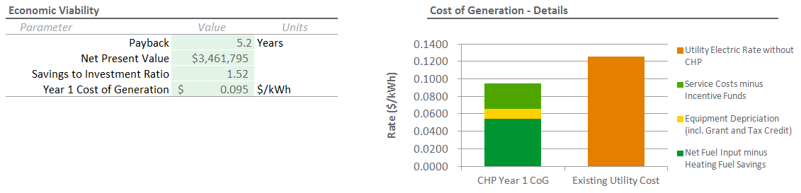
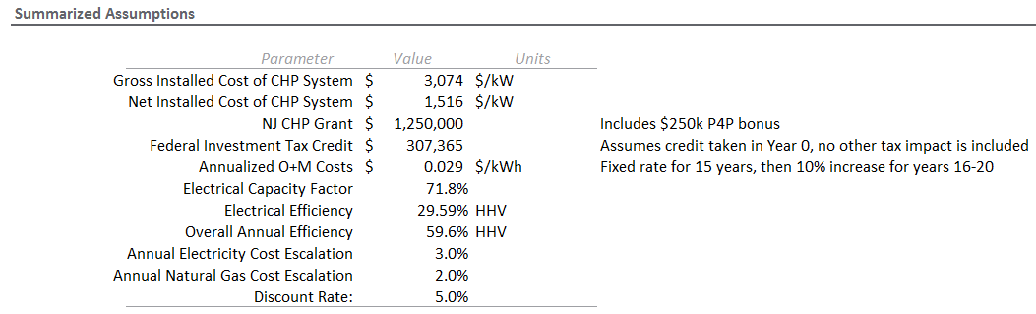
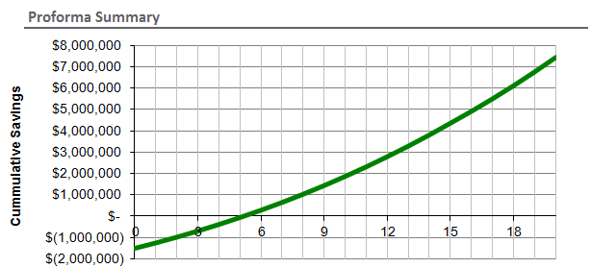
Example 2 - Estimated Financial Performance: 1MW Microturbine CHP
DISCLAIMER: The energy consumption and costs used in this analysis are based on certain assumptions and averages, and therefore, the output provided by this tool is for general information only and does not represent any real guarantee of performance of the system. Individual savings estimates will vary based on actual information provided to Schneider Electric.

Slide 51
Optional: Partnering with developers and investors to use sophisticated tools for precise DER sizing

Slide 52

Concept Design, Financials, and Development using MGT
Summary: How do I size DER for my clients?
Understand priorities – resilience, cost, GHG reduction
Understand funding – new DER? OPEX or CAPEX?
Get interval data for electrical service, thermal load
Understand tariffs and prices for gas and electrical
Understand federal, state a local incentives
If inverters are involved, what is anchor resource?
Understand NEPA, permitting, and air quality requirements

Slide 53


SE Microgrid Design Tool Analysis
Base Load Profile
Solar Profile
BESS Profile

Slide 54
Q & A, and reference slides

Slide 55


Microgrid Resources
Website
www.schneider-electric.us/microgrid
Visit the Boston One Campus for a microgrid tour
Digital Assets
Case Studies – partial lists
Energy-as-a-Service
MD: Montgomery County, Two advanced Microgrids – Duke Energy Renewables Investor
MA: Boston One Campus Advanced Microgrid – Duke Energy Renewables Investor
GA: MCLB Albany– Constellation Investor and prime contractor
Puerto Rico: US Coast Guard
Foxboro, MA
Design/Build
CT: Milford Public Purpose Microgrid, Fairfield Microgrids
WI: Gordon Bubolz Nature Preserve
IL: Shedd Aquarium, Ameren TAC
CA: MCAS Miramar 1 and 2
PA: Bear Creek Ski Resort
TX – Oncor
Whitepapers, Webinars & Videos
Virtual Tour
EcoStruxure Microgrid Advisor Info & Demo
Energy Control Center
https://youtu.be/DDi8I9IXg-U

